Slide 1
MINOR_3 SINGLE PORT RAM USING VERILOG
NAME | ID NO
N.E S W A R | 180040256
K.YOGANANDA SAGAR | 180040257
P.SRIVIDYA | 180040263
by
BATCH-16

Slide 2
ABSTRACT
This example describes a 64 bit x 8 bit single-port RAM design with common read and write addresses in Verilog.
In computing, memory refers to a device that is used to store information for immediate use in a computer or related computer hardware device. It typically refers to semiconductor memory, specifically metal–oxide–semiconductor memory, where data is stored within MOS memory cells on a silicon integrated circuit chip.

Slide 3
CONTENTS
Abstract
Introduction
Methodology
Programs
Outputs
Applications
Conclusion

Slide 4

INTRODUCTION
RAM (Random Access Memory) is the internal memory of the CPU for storing data, program, and program result. It is a read/write memory which stores data until the machine is working. As soon as the machine is switched off, data is erased.
Access time in RAM is independent of the address, that is, each storage location inside the memory is as easy to reach as other locations and takes the same amount of time. Data in the RAM can be accessed randomly but it is very expensive
RAM is volatile, i.e. data stored in it is lost when we switch off the computer or if there is a power failure. Hence, a backup Uninterruptible Power System (UPS) is often used with computers. RAM is small, both in terms of its physical size and in the amount of data it can hold.
RAM is of two types −
Static RAM (SRAM)
Dynamic RAM (DRAM)

Slide 5

Dynamic RAM (DRAM)
DRAM, unlike SRAM, must be continually refreshed in order to maintain the data. This is done by placing the memory on a refresh circuit that rewrites the data several hundred times per second. DRAM is used for most system memory as it is cheap and small. All DRAMs are made up of memory cells, which are composed of one capacitor and one transistor.
Characteristics of Dynamic RAM
Short data lifetime
Needs to be refreshed continuously
Slower as compared to SRAM
Used as RAM
Smaller in size
Less expensive
Less power consumption

Slide 6

Static RAM (SRAM)
The word static indicates that the memory retains its contents as long as power is being supplied. However, data is lost when the power gets down due to volatile nature. SRAM chips use a matrix of 6-transistors and no capacitors. Transistors do not require power to prevent leakage, so SRAM need not be refreshed on a regular basis.
There is extra space in the matrix, hence SRAM uses more chips than DRAM for the same amount of storage space, making the manufacturing costs higher. SRAM is thus used as cache memory and has very fast access.
Characteristic of Static RAM
Long life
No need to refresh
Faster
Large size
Expensive
High power consumption

Slide 7
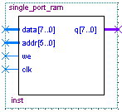
Methodology Single Port RAM

Slide 8
Ports Listing:-
Port Name | Type | Description
data[7:0] | Input | 8-bit data input
addr[5:0] | Input | 6-bit address input
we | Input | Write enable input
clk | Input | Clock input
q[7:0] | Output | 8-bit data output

Slide 9
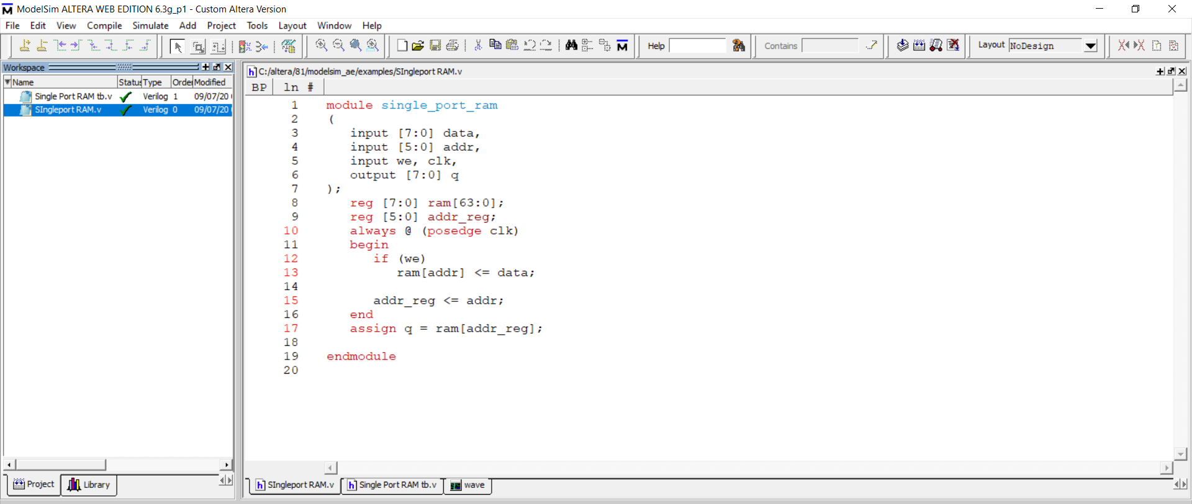
Program:-

Slide 10
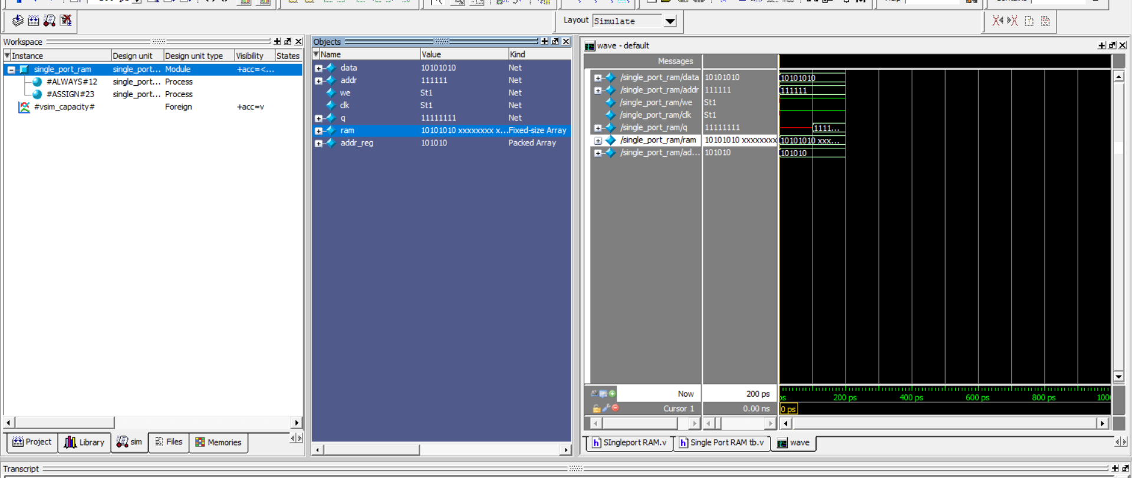
Output:-

Slide 11
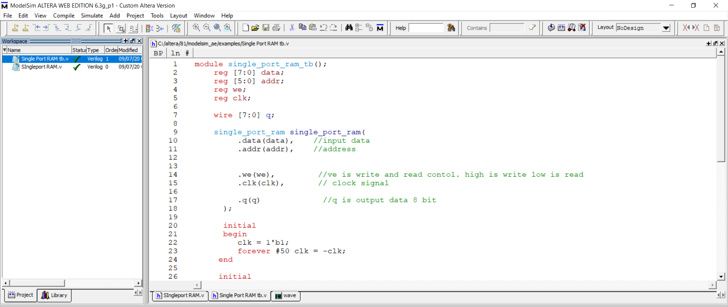
Test bench Program:-

Slide 12
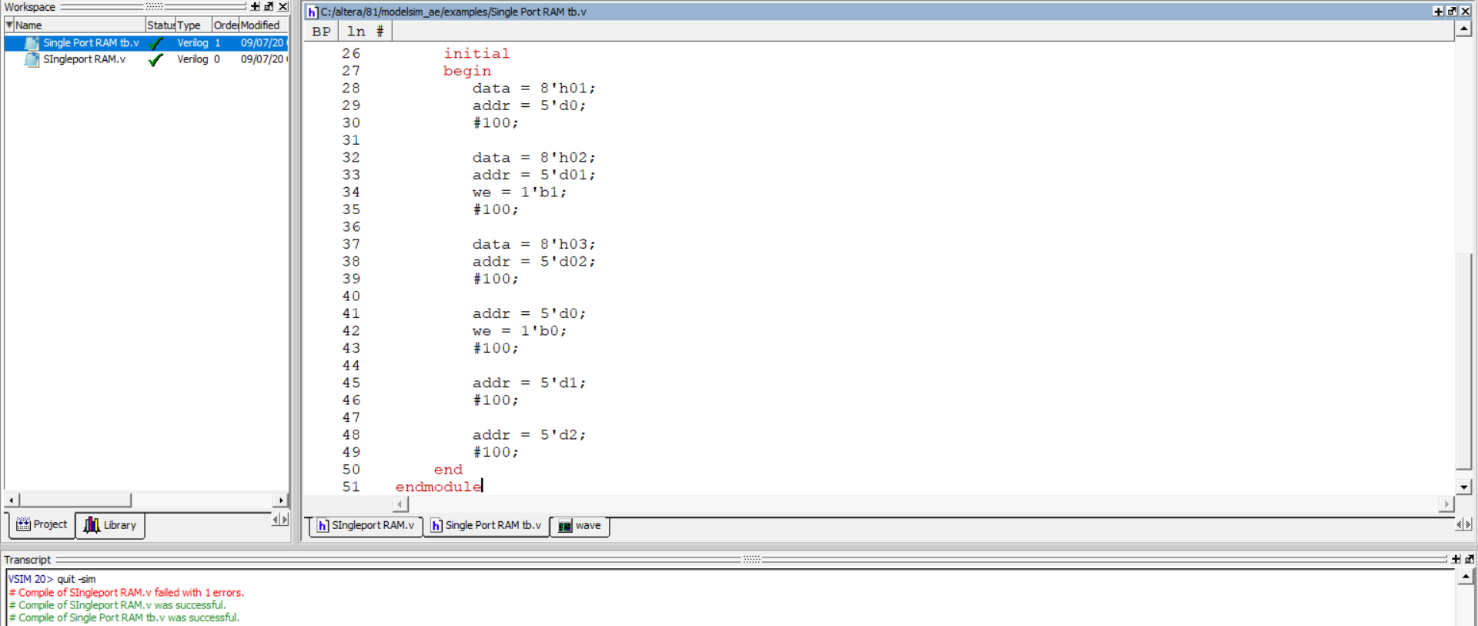
Tb contd…..

Slide 13
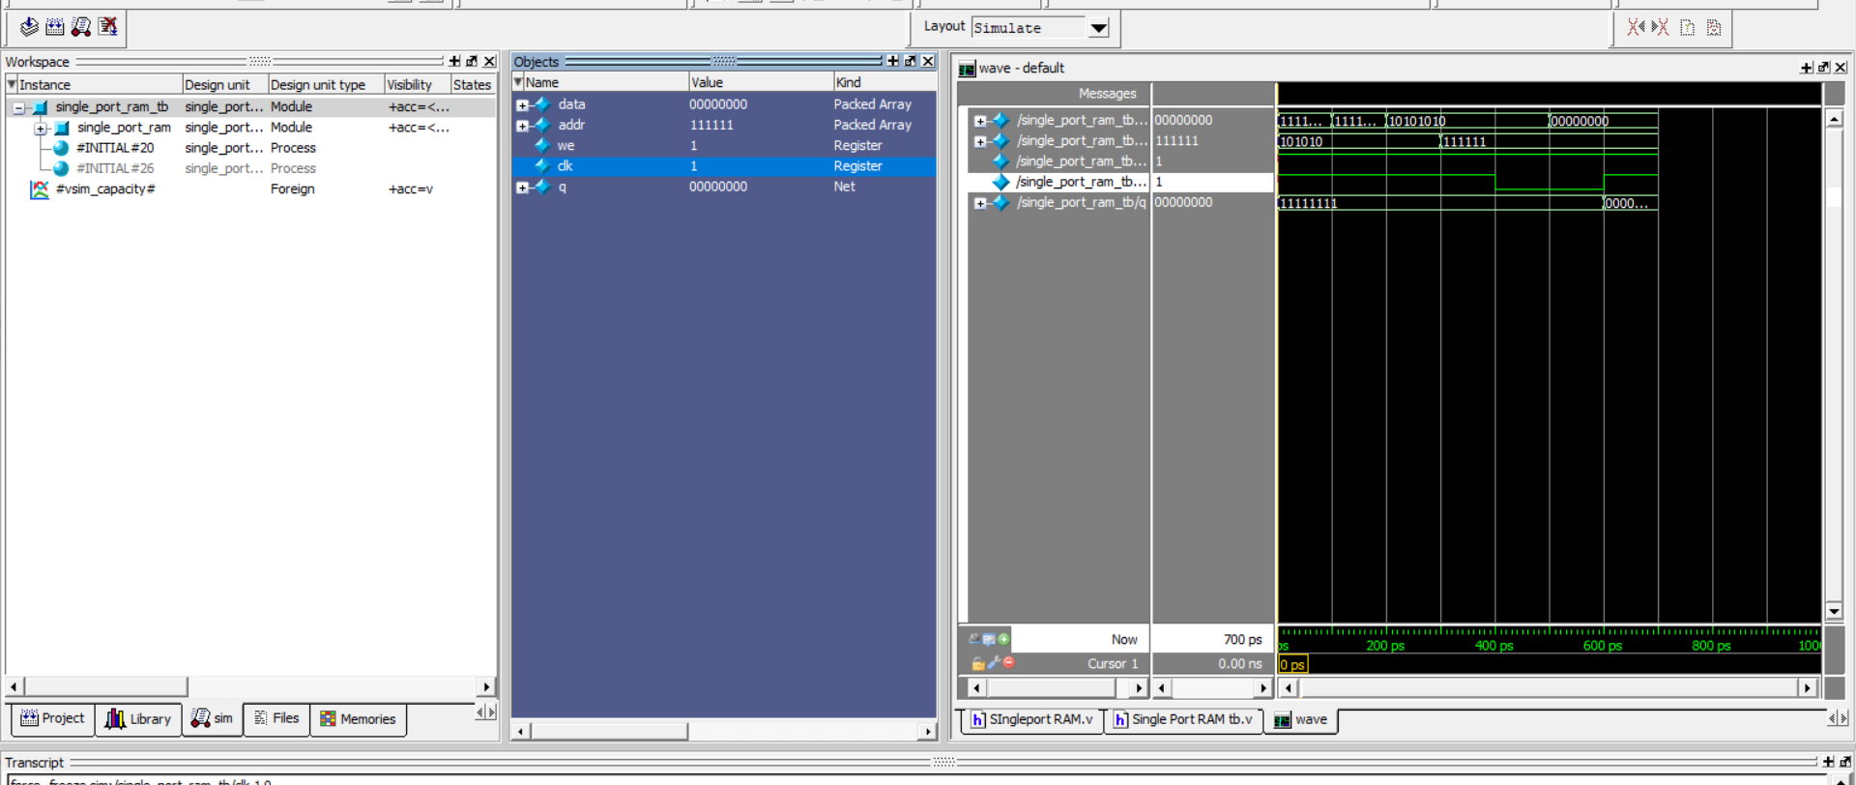
Test bench o/p:-

Slide 14
Applications:-
RAM allows your computer to perform many of its everyday tasks,
Such as loading applications.
Browsing the internet.
Editing a spreadsheet.
Experiencing the latest game.
Memory also allows you to switch quickly among these tasks.
Remembering where you are in one task when you switch to another task.

Slide 15
Conclusion
There are a few situations where having just 512 MB system memory in your computer can be enough. If you run your games at low quality settings (small texture size) because you have an outdated CPU and graphics card, or because you prefer FPS over visual quality. If you only use one application at a time.

Slide 16

THANK YOU

